Slide 1
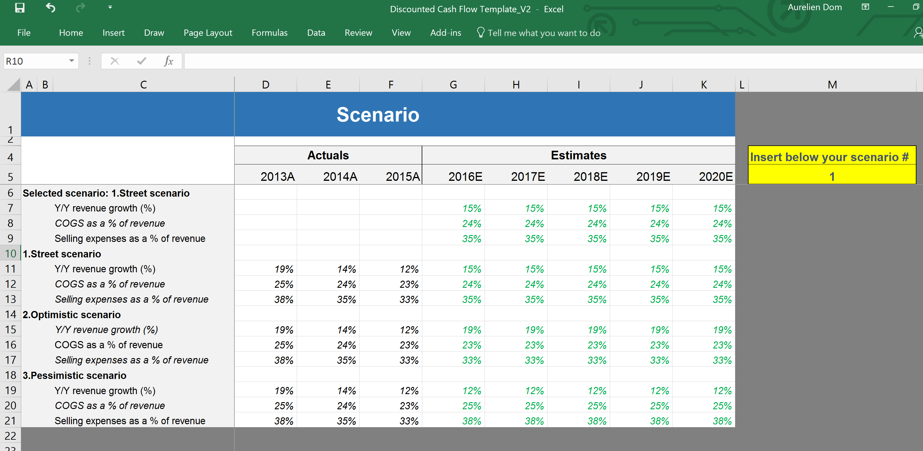
M&A Model Tutorial
Confidential
Created by former JP Morgan Investment Bankers, and McKinsey & Deloitte Consultants

Slide 2
Introduction
An M&A financial model is a type of financial model used in mergers and acquisitions to evaluate the financial implications of a potential transaction. This type of model incorporates financial statements, assumptions, and projections for both the acquiring and target companies. The model is used to evaluate various scenarios to determine the potential impact of the transaction on the financial performance of the combined company.
By creating an M&A financial model, analysts can estimate the impact of the acquisition on the combined company's income statement, balance sheet, and cash flow statement. This information is critical for determining the financial feasibility of the transaction, negotiating the purchase price, and securing financing.

Slide 3
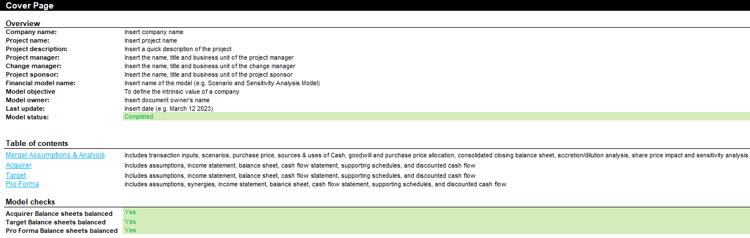
Open the document “M&A Model” and fill in the cover page

Slide 4
Beside the Cover Page, the M&A Financial Model includes 4 worksheets with different Building blocks
Acquirer
Target
Merger Assumptions & Analysis
Pro Forma
Assumptions with Different Scenarios
Assumptions with Different Scenarios
Transaction Inputs
Assumptions
Income Statement
Income Statement
Scenarios
Merger Integrations
Balance Sheet
Balance Sheet
Purchase Price
Income Statement
Cash Flow Statement
Cash Flow Statement
Sources & Uses of Cash
Balance Sheet
Working Capital
Working Capital
Goodwill and Purchase Price Allocation
Cash Flow Statement
Depreciations
Depreciations
Pro Forma Closing Balance Sheet
Working Capital
Debt & Interest
Debt & Interest
Accretion/Dilution Analysis
Depreciations
DCF
DCF
Impact on Acquirer Intrinsic Value per Share
Debt & Interest
Capital Structure
DCF
Sensitivity Analysis

Slide 5
Let’s zoom on the Acquirer Worksheet
Acquirer
Target
Merger Assumptions & Analysis
Pro Forma
Assumptions with Different Scenarios
Assumptions with Different Scenarios
Transaction Inputs
Assumptions
Income Statement
Income Statement
Scenarios
Merger Integrations
Balance Sheet
Balance Sheet
Purchase Price
Income Statement
Cash Flow Statement
Cash Flow Statement
Sources & Uses of Cash
Balance Sheet
Working Capital
Working Capital
Goodwill and Purchase Price Allocation
Cash Flow Statement
Depreciations
Depreciations
Pro Forma Closing Balance Sheet
Working Capital
Debt & Interest
Debt & Interest
Accretion/Dilution Analysis
Depreciations
DCF
DCF
Impact on Acquirer Intrinsic Value per Share
Debt & Interest
Capital Structure
DCF
Sensitivity Analysis

Slide 6
You can create the Acquirer Worksheet in 9 simple steps
Click on the Acquirer tab and make sure that you do not need to add or remove a building block based on your specificities
Adjust if required the periodicity based on the specificities of your organization
Adjust if required the items in each building block
Fill in the templates focusing on the 3 financial statements, 3 supporting schedules and your “base scenario” in your “assumptions” building block
Double check that your balance sheet is balanced
Create your DCF building block
Create more scenarios in the building block “Assumptions”
Select the Scenario that will flow in the model
Add a Stub period

Slide 7
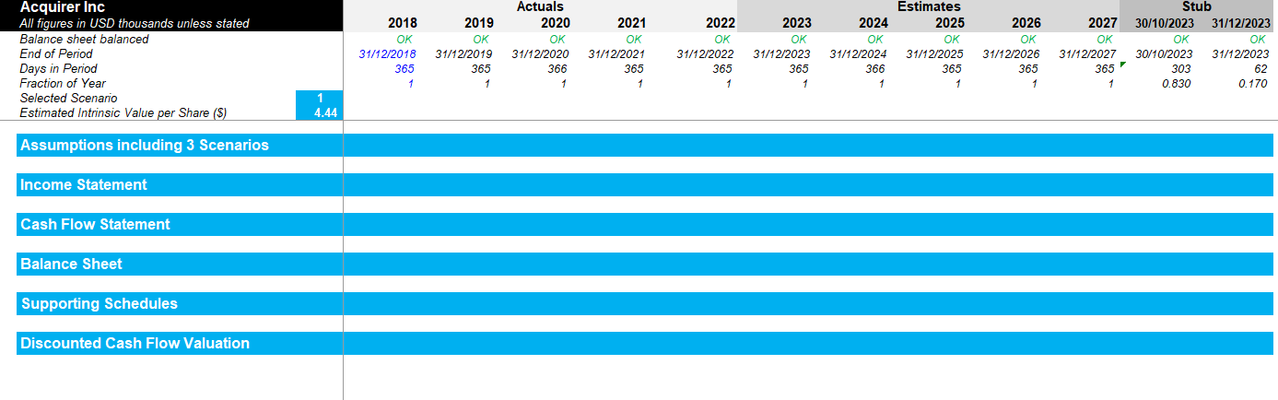
Step 1 - Click on the Acquirer tab and make sure that you do not need to add or remove a building block based on your specificities

Slide 8
Step 2 - Adjust if required the periodicity based on the specificities of your organization

Slide 9
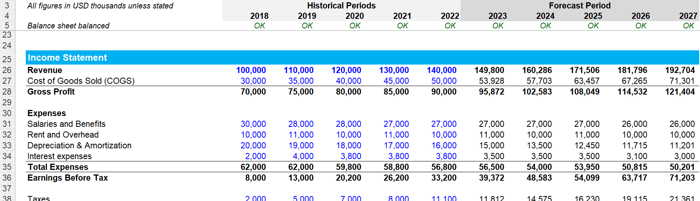
Step 3 - Adjust if required the items in each building block
For example, you may decide to add the item “Dividend payout” by adding a row. Or you may decide to remove the interest expenses. If required, you may have to add a row in the assumption building block if it helps you forecast the future dividend payout

Slide 10
Step 4 - Fill in the templates focusing on the 3 financial statements, 3 supporting schedules and your “base scenario” in your “assumptions” building block
Actuals
Forecast
Assumptions with different scenarios
2. Mainly formula and links
3. Mainly input
Income statement
1. Mainly input
4. Mainly formula and links
Balance sheet
Cash flow statement
Working capital
Depreciations
Debt & Interest
DCF
5

Slide 11
Step 5 - Double check that your balance sheet is balanced
Asset
Liabilities + Shareholders’ Equity
Current asset
Current liabilities
Where the money is going to
Fixed Assets
Where the money is coming from
Long-term Liabilities
Intangible Assets
Shareholder’s Equity & Retained Earnings

Slide 12
If the balance sheet is not balanced, review all your inputs, formulas and links Example of how the income statement and cash flow statement can be linked
From Income statement…
…to Cash flow statement
Revenue
Net income adjusted
Cost of goods sold
Depreciation and amortization
Gross profit
Deferred income taxes
Operating expenses
Changes in accounts receivable
Operating activities
EBITDA
Changes in inventory
Depreciation and amortization
Changes in accounts payable
EBIT
Changes in accrued liabilities
Interest
CAPEX
Investing activities
Income tax expense
Other investing activities
Net Income (Adjusted)
Debt
Net Income
Dividends paid
Financing activities
Dividend payout
Equity Issuances (buybacks)
Net income after distribution
Total change in cash

Slide 13
If the balance sheet is not balanced, review all your inputs, formulas and links Example of how the cash flow statement can be linked directly to the balance sheet
From Cash flow statement…
…to Balance Sheet
Net income adjusted
Cash
Depreciation and amortization
Receivables, net
Deferred income taxes
Inventories
Asset
Operating activities
Changes in accounts receivable
Property, plant and equipment, net
Changes in inventory
Other long-term assets
Changes in accounts payable
Accounts payable
Changes in accrued liabilities
Accrued liabilities
CAPEX
Liabilities
Investing activities
Debt
Other investing activities
Debt
Deferred income taxes
Dividends paid
Equity
Financing activities
Equity
Equity Issuances (buybacks)
Retained earnings
Total change in cash

Slide 14
Step 6 - Create your DCF building block following the instructions displayed in the next slides
Actuals
Forecast
Assumptions with different scenarios
2. Mainly formula and links
3. Mainly input
Income statement
1. Mainly input
4. Mainly formula and links
Balance sheet
Cash flow statement
Working capital
Depreciations
Debt & Interest
DCF
5

Slide 15
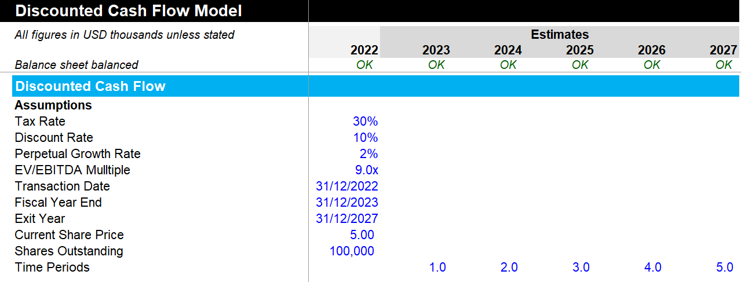
Insert your assumptions in the building block “Discounted Cash Flow”
The discount rate is usually the Weighted Average Cost of Capital (WACC). You can open our WACC Model folder for more details on how to calculate the WACC

Slide 16
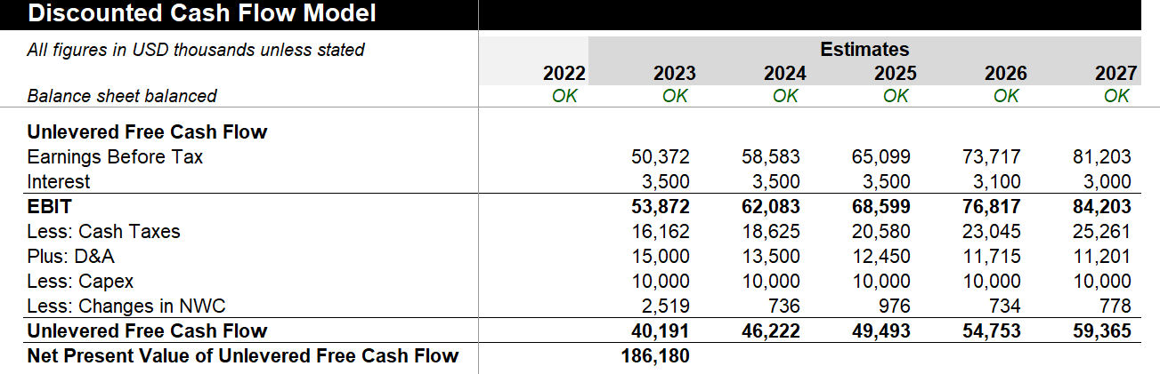
Estimate the Unlevered Free Cash Flow
Ideally all these figures should be pulled from either the income statement or the Balance sheet
Since $1 earned in the future is worth less than $1 earned today, it is important to calculate the Net Present Value of Unlevered Free Cash Flow

Slide 17
Calculate the Net Present Value of Unlevered Free Cash Flow
Since $1 earned in the future is worth less than $1 earned today, it is important to calculate the Net Present Value of Unlevered Free Cash Flow

Slide 18
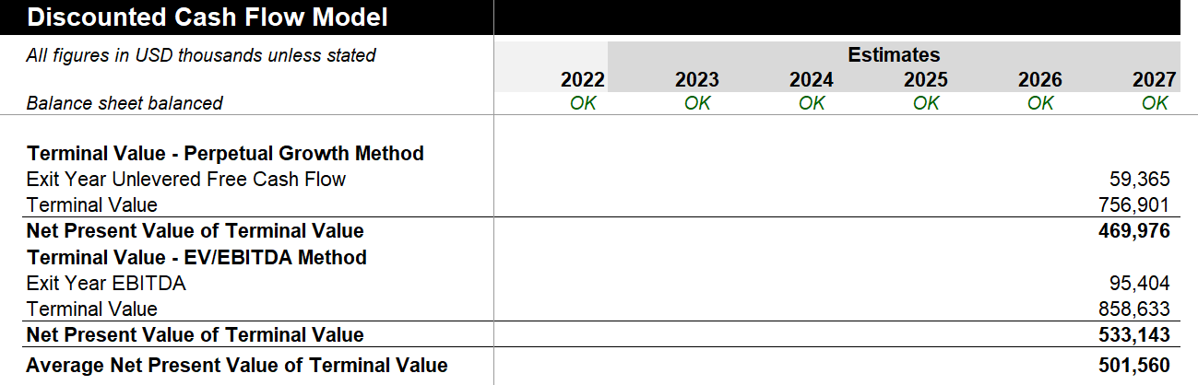
Calculate the Net Present Value of Terminal Value using the Perpetual Growth Method and the EV/EBITDA Method

Slide 19
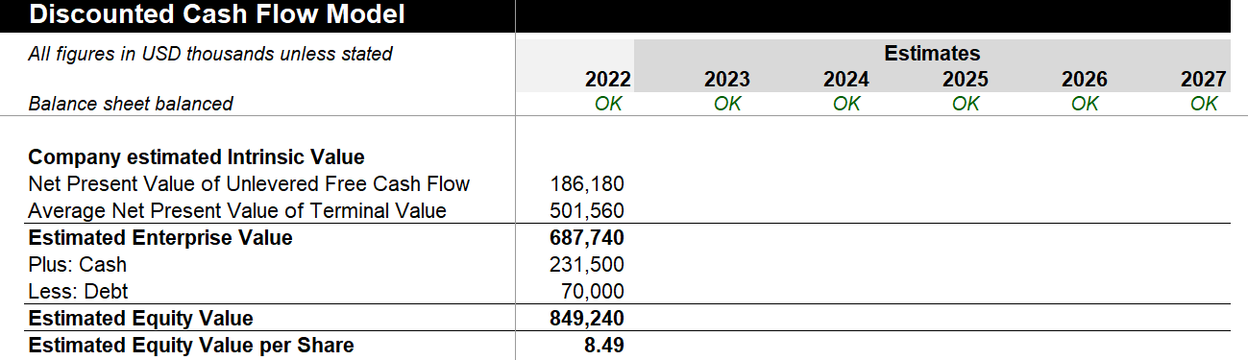
Calculate the Company estimated Intrinsic Value

Slide 20
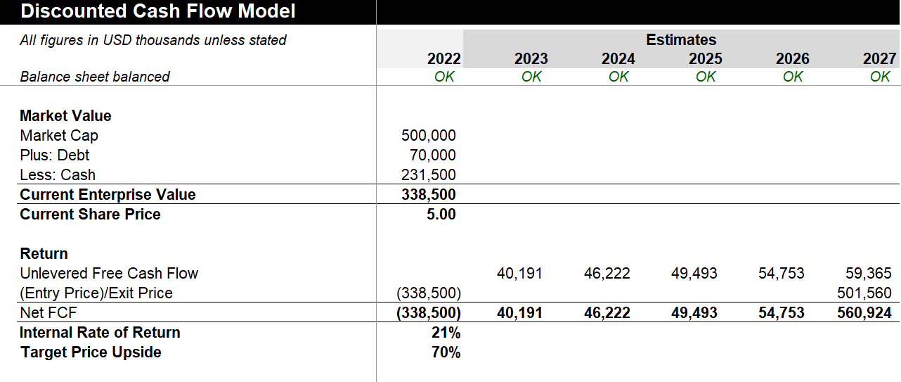
Calculate the current Market Value of the company

Slide 21
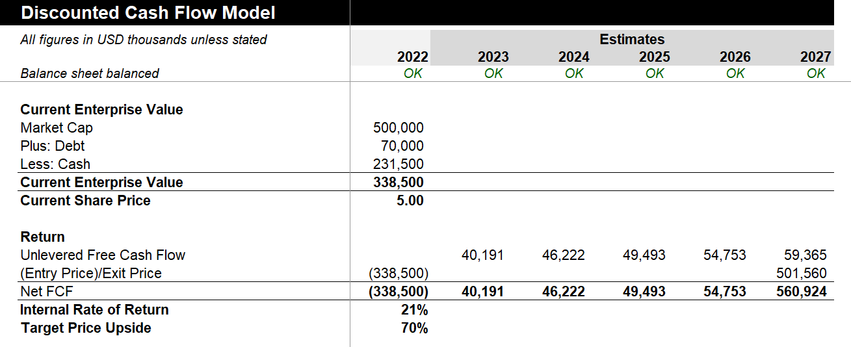
Calculate your Internal Rate of Return based on the company estimated intrinsic value and the Market Value

Slide 22
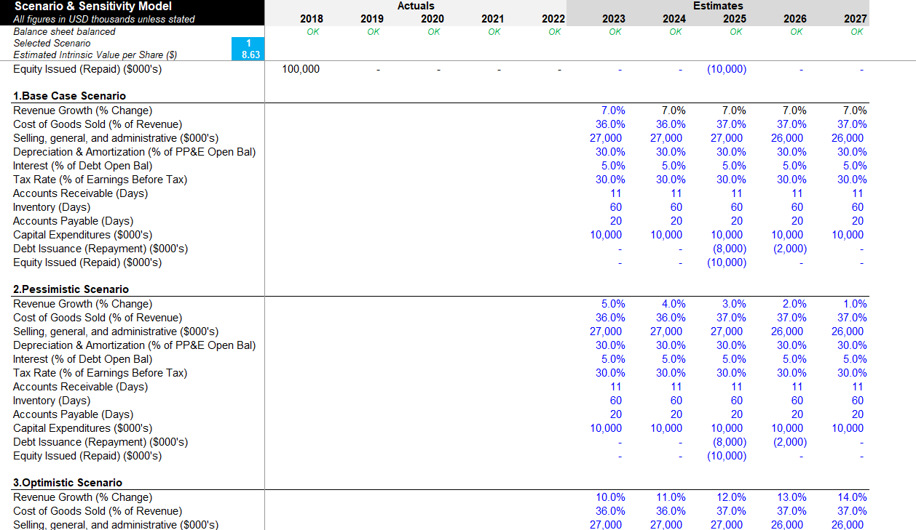
Step 7 - Create more scenarios in the building block “Assumptions”
In our template, we created a Base Case Scenario, a Pessimistic Scenario and an Optimistic Scenario. You can of course change the name of the scenarios (e.g. Best case scenario, Worst case scenario, etc.)

Slide 23
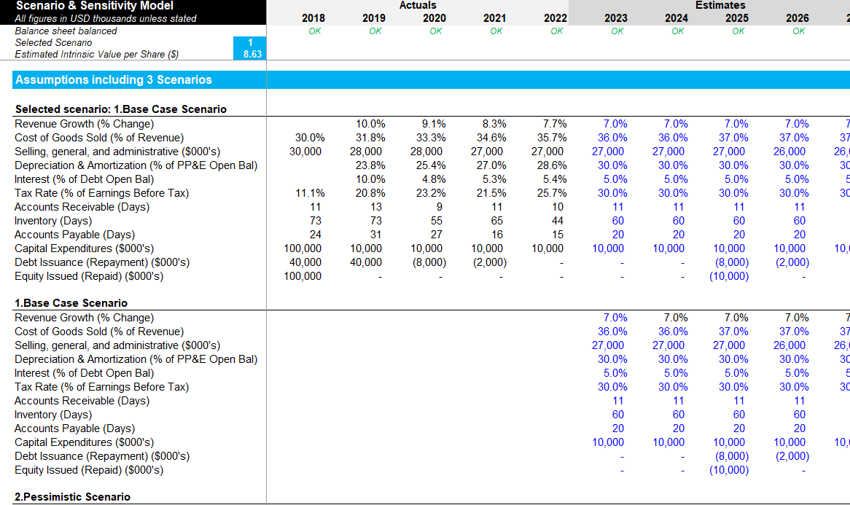
Step 8 - Select the Scenario that will flow in the model
Here we selected the scenario 1.
The estimated intrinsic value per share will update automatically based on selected scenario
As a result, the “Selected scenario” will automatically display the input from the “1.Base Case Scenario”.
If we had selected the scenario 2, the “Selected scenario” would have automatically displayed the input from the “2.Pessimistic Scenario”

Slide 24
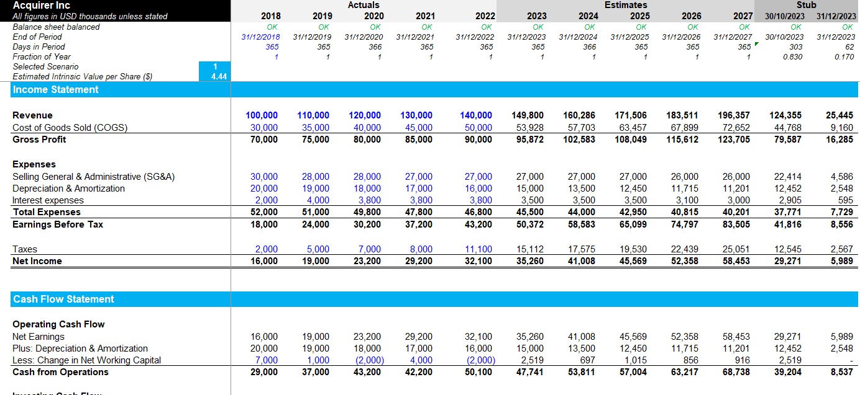
Step 9 - Add a Stub periodThe Acquirer and Target worksheets can be created by reusing the blocks we used in the 3 statement financial model, DCF model and the scenario and sensitivity model
A stub period refers to a short period of time (usually less than a year) for which financial projections are made after the closing date of the acquisition. This stub period is included in the financial model to reflect the financial performance of the target company and to help estimate the impact of the acquisition on the acquirer's financial statements. The stub period projections are typically used to assess the financial impact of the acquisition on the acquirer's earnings per share (EPS) and other financial metrics.

Slide 25
The Target Worksheet can easily be created by using the same steps described for the Acquirer Worksheet
Acquirer
Target
Merger Assumptions & Analysis
Pro Forma
Assumptions with Different Scenarios
Assumptions with Different Scenarios
Transaction Inputs
Assumptions
Income Statement
Income Statement
Scenarios
Merger Integrations
Balance Sheet
Balance Sheet
Purchase Price
Income Statement
Cash Flow Statement
Cash Flow Statement
Sources & Uses of Cash
Balance Sheet
Working Capital
Working Capital
Goodwill and Purchase Price Allocation
Cash Flow Statement
Depreciations
Depreciations
Pro Forma Closing Balance Sheet
Working Capital
Debt & Interest
Debt & Interest
Accretion/Dilution Analysis
Depreciations
DCF
DCF
Impact on Acquirer Intrinsic Value per Share
Debt & Interest
Capital Structure
DCF
Sensitivity Analysis

Slide 26
Let’s now zoom on the Merger Assumptions & Analysis Worksheet
Acquirer
Target
Merger Assumptions & Analysis
Pro Forma
Assumptions with Different Scenarios
Assumptions with Different Scenarios
Transaction Inputs
Assumptions
Income Statement
Income Statement
Scenarios
Merger Integrations
Balance Sheet
Balance Sheet
Purchase Price
Income Statement
Cash Flow Statement
Cash Flow Statement
Sources & Uses of Cash
Balance Sheet
Working Capital
Working Capital
Goodwill and Purchase Price Allocation
Cash Flow Statement
Depreciations
Depreciations
Pro Forma Closing Balance Sheet
Working Capital
Debt & Interest
Debt & Interest
Accretion/Dilution Analysis
Depreciations
DCF
DCF
Impact on Acquirer Intrinsic Value per Share
Debt & Interest
Capital Structure
DCF
Sensitivity Analysis

Slide 27
Step 1 - Transaction inputs
You’ll see in the next slides the definition of some key terms included in the “Transaction inputs” building block.

Slide 28
Step 1 - Transaction inputs Restructuring Charges
Restructuring charges refer to the expenses associated with significant changes in the operations or structure of a company resulting from a merger or acquisition. These charges are incurred to implement cost-saving initiatives, consolidate operations, and integrate the acquired company into the existing business.
Restructuring charges are generally one-time expenses that can be significant in the year of the merger or acquisition, but can also have ongoing effects on the financial performance of the combined company. Some common examples of restructuring charges include severance payments to employees who are laid off, write-offs of assets that are no longer necessary, and costs associated with relocating or consolidating facilities.
In an M&A financial model, restructuring charges are included in the projected financial statements as part of the pro forma adjustments. These adjustments are made to reflect the impact of the merger or acquisition on the financial statements of the combined company. The restructuring charges are typically included as an expense item in the income statement, and may also be reflected in the balance sheet and cash flow statement depending on the nature of the charges.

Slide 29
Step 1 - Transaction inputs Equity and Debt Issuance Fees
Equity issuance fees in an M&A financial model refer to the fees paid to investment banks or other financial institutions for underwriting and assisting with the issuance of new equity securities. When a company decides to issue new equity securities, such as common stock or preferred stock, to raise capital, they may hire an investment bank to underwrite the issuance and help with marketing the securities to potential investors. The investment bank will charge a fee for these services, which is recorded as an expense in the M&A financial model. The equity issuance fees are typically calculated as a percentage of the total amount of equity issued and are included in the overall transaction costs of the M&A deal.
Debt Issuance Fees refer to the costs incurred by a company in connection with the issuance of new debt. In an M&A Financial Model, if a company is planning to raise debt to finance an acquisition, it may need to pay fees to investment banks, lawyers, and other advisors involved in the debt issuance process. These fees are usually a percentage of the total amount of debt raised and can be significant. In the M&A Financial Model, Debt Issuance Fees are typically included as a financing cost and deducted from the proceeds of the debt issuance.

Slide 30
Step 1 - Transaction inputs Replace Target Debt
In an M&A financial model, "Replace Target Debt" refers to the process of replacing the existing debt of the target company with new debt after the acquisition. This is typically done to optimize the capital structure of the newly combined company and ensure that it has the appropriate mix of debt and equity to support its operations and growth plans.
In the context of an M&A financial model, the Replace Target Debt line item reflects the cost of retiring the target company's existing debt and issuing new debt in its place. This cost can include prepayment penalties, transaction fees, and other expenses associated with retiring and replacing debt.
Replacing the target company's debt can have a significant impact on the financial performance and financial statements of the combined company. It can change the interest expense, debt levels, and debt maturity profile, which in turn can affect the company's credit rating and financial flexibility. Therefore, it is an important consideration in the M&A financial model.

Slide 31
Step 1 - Transaction inputs Replace Acquirer Debt
"Replace Acquirer Debt" refers to the assumption that the acquirer will repay or refinance its existing debt using the cash or proceeds from the deal. This is often done to optimize the acquirer's capital structure and take advantage of favorable market conditions.
For example, the acquirer may have high-interest rate debt or debt that is maturing soon, which can be replaced with lower-cost debt after the acquisition. The cost savings from the lower interest rate can improve the acquirer's financial performance and increase the overall value of the deal.
The Replace Acquirer Debt assumption is typically included in the sources and uses of funds section of an M&A financial model, which outlines how the deal will be financed and what the cash flow implications will be. It is important to accurately model this assumption in order to properly evaluate the financial impact of an acquisition.

Slide 32
Step 1 - Transaction inputs Acquirer Fully Diluted Shares Outstanding
Acquirer FD Shares Outstanding in an M&A Financial Model refers to the total number of shares of the acquirer company that are available for public trading or held by investors at the time of the acquisition. This information is important in determining the value of the acquirer company's shares, which may be used as consideration in the M&A deal. The Acquirer FD Shares Outstanding is also used in calculating the dilution of ownership for the acquirer's shareholders as a result of the acquisition, as well as in determining the impact of the transaction on the acquirer's earnings per share.
"FD" stands for "fully diluted". Fully diluted shares refer to the total number of shares outstanding if all potential sources of dilution were exercised or converted into common shares. This includes all outstanding common shares, as well as any potentially dilutive securities such as stock options, convertible bonds, or warrants that could be converted into common shares in the future. By including fully diluted shares in financial modeling, analysts can get a more accurate picture of the company's overall ownership and value, as well as the impact of any potential dilution on earnings per share and other financial metrics.

Slide 33
Step 1 - Transaction inputs Target Fully Diluted Share Outstanding
Target FD Shares Outstanding refers to the number of fully diluted shares outstanding of the target company, which includes all outstanding shares as well as any potentially dilutive securities, such as stock options, warrants, or convertible securities.
This metric is important to consider in an M&A transaction because the acquirer will be acquiring the target company's equity, and the value of the equity will depend on the number of outstanding shares. If the target company has a large number of potentially dilutive securities, the acquirer may need to pay a higher price per share to account for the potential dilution.
In financial modeling, Target FD Shares Outstanding is typically used to calculate the acquisition price per share, which is the total consideration paid for the target company divided by the number of fully diluted shares outstanding.

Slide 34
Step 1 - Transaction inputs Share Issuance Discount and Share Issuance Price
The share issuance discount refers to the reduction in the market price of a company's shares that are issued during a merger or acquisition. This discount is often applied because investors may perceive the shares as being riskier due to the uncertainty surrounding the M&A transaction. As a result, the issuing company may have to offer a discount to entice investors to purchase the shares. The discount is typically represented as a percentage reduction from the market price of the shares at the time of the issuance. The share issuance discount is an important consideration in calculating the net proceeds of a share issuance and can impact the valuation of the company.
"Share Issuance Price" refers to the price at which the acquirer issues new shares to finance the acquisition of the target company. This price is important because it determines the amount of funds raised by the acquirer through the issuance of new shares and also impacts the dilution of existing shareholders. The share issuance price is typically determined based on the market price of the acquirer's shares at the time of the issuance, and may be subject to negotiation with investors or underwriters.

Slide 35
Step 2 - Scenarios
This building block includes multiple scenarios with different assumptions regarding the transaction, the synergy targets and the financing of the deal

Slide 36
Step 3 - Purchase Price
Takeover premium: The takeover premium refers to the amount that the acquiring company pays above the current market value of the target company in order to acquire it. This premium is often expressed as a percentage of the target company's current share price or total equity value. The takeover premium is one of the key factors that determines the total purchase price of the target company, along with other factors such as any assumed debt, transaction expenses, and potential synergies between the two companies. The premium is usually based on various factors such as the strategic value of the target company, the competitiveness of the bidding process, and the bargaining power of the target company's management or shareholders.
Share exchange ratio: The share exchange ratio represents the number of acquiring company's shares that will be exchanged for each share of the target company. This ratio is determined based on the relative valuations of the two companies and is a critical component of the acquisition agreement. The share exchange ratio is used to calculate the total number of shares that will be issued to the target company's shareholders, as well as the total value of the transaction. The share exchange ratio is typically expressed as a fraction or a decimal, such as 0.75 shares of the acquiring company for each share of the target company.

Slide 37
Step 4 - Sources & Uses of cash
The "Sources and Uses of Cash" schedule is a crucial component of an M&A financial model. It outlines the expected sources and uses of cash for the transaction.
On the "Sources" side, the schedule lists all the ways the acquirer will generate cash to finance the acquisition, such as cash on hand, debt financing, or equity financing. On the "Uses" side, it details how the acquirer will use the cash to fund the transaction, such as paying for the target company, paying transaction fees, or refinancing existing debt.
The purpose of this schedule is to ensure that the acquirer has sufficient funding to complete the acquisition, and to provide a clear picture of where the cash is coming from and how it will be used. It is often used in conjunction with other schedules, such as the debt and equity financing schedules, to create a comprehensive view of the financing structure of the transaction.

Slide 38
Step 4 - Sources & Uses of cash
The "Sources and Uses of Cash" schedule is a crucial component of an M&A financial model. It outlines the expected sources and uses of cash for the transaction.
On the "Sources" side, the schedule lists all the ways the acquirer will generate cash to finance the acquisition, such as cash on hand, debt financing, or equity financing. On the "Uses" side, it details how the acquirer will use the cash to fund the transaction, such as paying for the target company, paying transaction fees, or refinancing existing debt.
The purpose of this schedule is to ensure that the acquirer has sufficient funding to complete the acquisition, and to provide a clear picture of where the cash is coming from and how it will be used. It is often used in conjunction with other schedules, such as the debt and equity financing schedules, to create a comprehensive view of the financing structure of the transaction.

Slide 39
Step 4 - Sources & Uses of cash Cash Consideration
The term "cash consideration" refers to the cash payment made by the acquirer to the target company's shareholders in exchange for their shares. The cash consideration is one of the sources of cash in the "Sources and Uses of Cash" schedule, which outlines how the acquirer will finance the acquisition. The amount of cash consideration is typically based on the agreed-upon purchase price and the number of shares outstanding, and it can have a significant impact on the overall cash flow implications of the transaction.

Slide 40
Step 5 - Goodwill and purchase price allocation
The Goodwill and purchase price allocation schedule in an M&A financial model is used to determine the value of goodwill and other intangible assets acquired during a merger or acquisition. It is an important part of the financial modeling process, as it helps to determine the value of the assets and liabilities that are acquired in the transaction, and how they will be recorded on the acquirer's balance sheet.
The schedule typically includes a breakdown of the purchase price paid for the target company. It will also include a detailed analysis of the target company's assets and liabilities, which will help to determine the value of any goodwill or intangible assets that are acquired as part of the transaction.
Once the purchase price has been allocated to the target company's assets and liabilities, the remaining balance is considered to be goodwill. Goodwill represents the value of the target's intangible assets, such as brand value, intellectual property, and customer relationships, which are not reflected on its balance sheet. The goodwill and other intangible assets are then recorded on the acquirer's balance sheet and are subject to periodic impairment testing to ensure that their values are not overstated.

Slide 41
Step 5 - Goodwill and purchase price allocation Book Value and Net Book Value
Book value refers to the value of the assets and liabilities of the acquired company as they are recorded on the company's balance sheet. The book value is often used as a starting point for determining the fair market value of the assets and liabilities of the acquired company.
The net book value is calculated by subtracting the total liabilities from the total assets.

Slide 42
Step 5 - Goodwill and purchase price allocation Fair Value and Identifiable Intangibles
Fair value typically refers to the estimated market value of an asset or liability. When a company acquires another company, it may need to allocate the purchase price paid for the acquisition among the acquired company's identifiable assets and liabilities. The fair value of each identifiable asset and liability is determined based on estimates of its market value at the time of acquisition. This information is used to determine the amount of goodwill that should be recorded on the acquiring company's balance sheet. The fair value of an asset or liability is often determined through a combination of methods, including market data, discounted cash flow analysis, and other valuation techniques.
Identifiable Intangibles refer to intangible assets that can be identified and separately valued in the acquisition of a company. These intangible assets may include patents, trademarks, copyrights, customer lists, and other intellectual property that are expected to generate future economic benefits. In the purchase price allocation process, the fair value of these identifiable intangible assets is estimated and recorded separately from the goodwill. This allows the acquirer to account for the value of these assets and amortize them over their useful lives for accounting and tax purposes.

Slide 43
Step 6 - Consolidated Closing Balance Sheet (Pro Forma)
In the context of mergers and acquisitions (M&A), a consolidated closing balance sheet (pro forma) is a financial statement that combines the balance sheets of two or more companies involved in the transaction. It provides a snapshot of the financial position of the combined entity after the completion of the M&A deal.
The consolidation also includes:
The fair value of the target’s assets
The goodwill
The financing of the deal
The refinancing of the debt

Slide 44
Step 7 - Accretion/Dilution Analysis
Accretion/dilution analysis is a financial analysis technique used in mergers and acquisitions (M&A) to assess the impact of the transaction on the acquiring company's earnings per share (EPS). It helps determine whether the transaction is expected to be accretive (increase EPS) or dilutive (decrease EPS) to the acquiring company's shareholders.

Slide 45
Step 8 - Impact on Acquirer Intrinsic Value per Share
The purpose of this building block is to see how the Acquirer Intrinsic Value per Share is impacted by the deal.

Slide 46
Step 9 - Capital Structure
The objective of the capital structure schedule in an M&A model is to analyze and determine the appropriate capital structure for the combined entity resulting from the merger or acquisition. It provides insights into the composition of the company's capital, including debt and equity, and helps optimize the capital mix to achieve financial goals and maximize shareholder value.

Slide 47
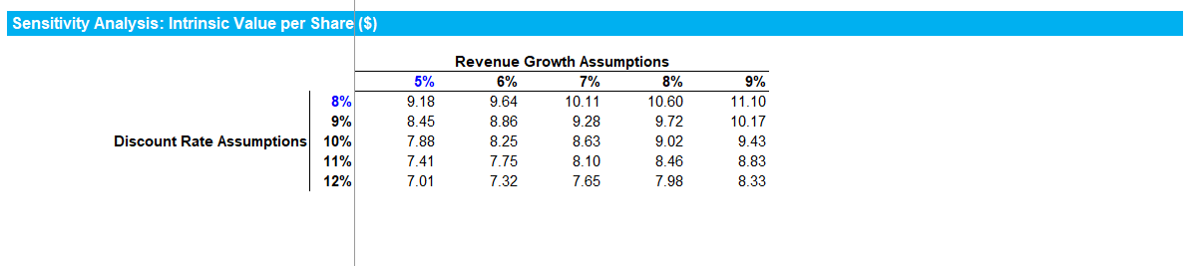
Step 10 - Sensitivity Analysis
Select the metric you want to analyze.
In this example, we want to analyze the sensitivity of the “Intrinsic Value per share”. But we could have chosen another metric, such as the “Net Income”, or the “Intrinsic Value”
Select the 2 metrics you want to use to see how the “Intrinsic Value per share” changes.
In this example, we decided to analyze the sensitivity of the “Intrinsic Value per share” based on the “Discount rate” and the “Revenue Growth”. Once again, you could have chosen another metric such as the EV/EBITDA Multiple

Slide 48
Create the Sensitivity Analysis table (1/3)
Link this cell to the metric you want to analyze. In this example, the cell is linked to the metric “Intrinsic Value per share”. And we put it in white as se only need it to create our sensitivity table.
Insert the different revenue growth you want to test, making sure that the revenue growth in the middle is the current revenue growth used in the model. In this example, the revenue growth in the middle is “7%”
Insert the different discount rate you want to test, making sure that the discount rate in the middle is the current discount rate in the model. In this example, the discount rate in the middle is “10%”

Slide 49
Create the Sensitivity Analysis table (2/3)
Select the whole table, then click on the tab “Data” and then click on “What if analysis” and finally on “Data table”

Slide 50
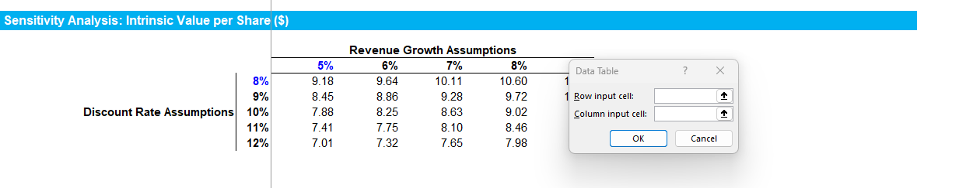
Create the Sensitivity Analysis table (3/3)
A data table will open. Select the 2 input cells that you want the sensitivity table to test. In our example, the row input cell that we want to test is the cell J24, which is our current revenue growth. And the column input cell that we want to test is the cell I153, which is our current discount rate.
Once you press “OK”, the different share prices will appear.
This share price should be the one currently in the model, as the model has a revenue growth of 7% and a discount rate of 10%

Slide 51

Interested in more than 1 Toolkit? Access all our Toolkits for half the price with our Gold Access
Gold Access
Click here to learn more

Slide 52

Thanks for your attention!
www.domontconsulting.com

